Slide 1

User Adaptive Systems Seminar
Final Presentation
Paul Ferlitz, Anne Hoff, Marcel Namyslo, Fabian Weschenfelder, Joris Wessels
27.07.2020

Slide 2
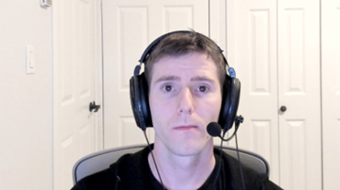

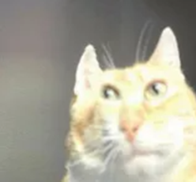
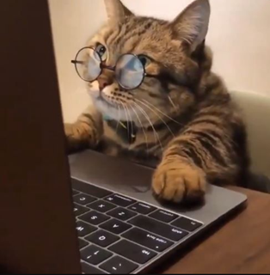



Slide 3

Application Overview
Notes:
Joris gives an overview of the key functionalities and the graphical interfaces

Slide 4
What is our application capable of?
Redirect users' attention to what is currently important
Helps the user to stay focused longer
Give insights about the reason for the attention loss
Enables a learning process for the user
Prevent attention loss in the first place

Slide 5
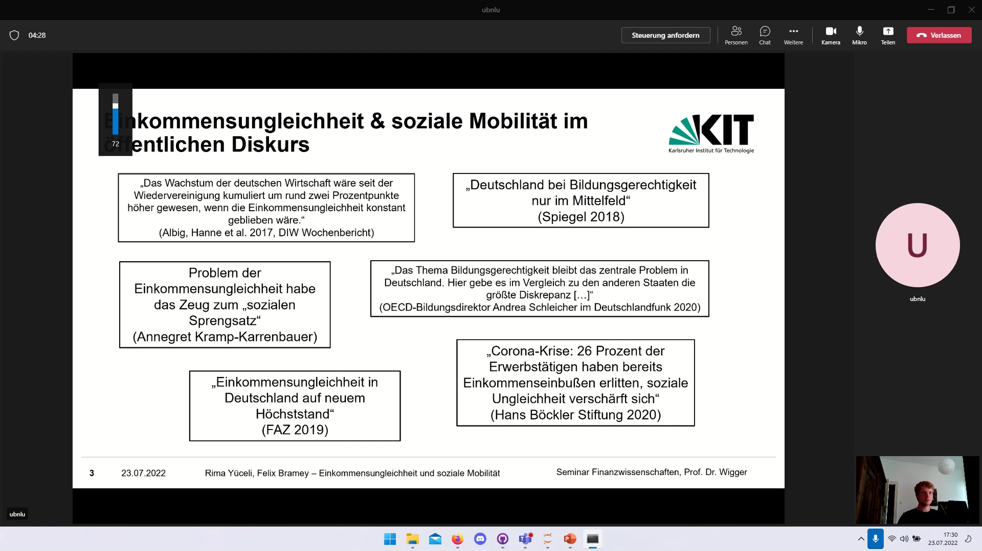
First look at our application

Slide 6
Let‘s have a closer look
GUI consists of three main interfaces:
Interface for launch
Interface for Popup's
Interface for the final summary
Each Interface helps to reach a function of our application
Launch Interface enables prevention
Popup Interface enables reaction to attention loss
Summary Interface enables the learning process

Slide 7
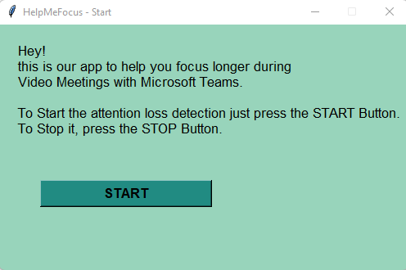
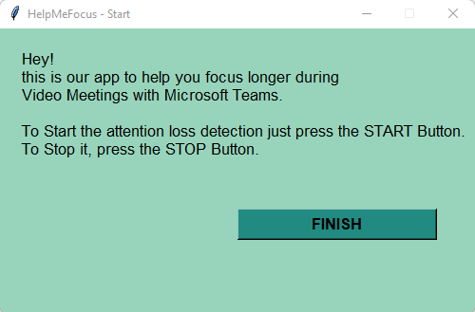
Interface for launch
Only strictly necessary information
User is heavily guided
Starts and finishes the recording

Slide 8
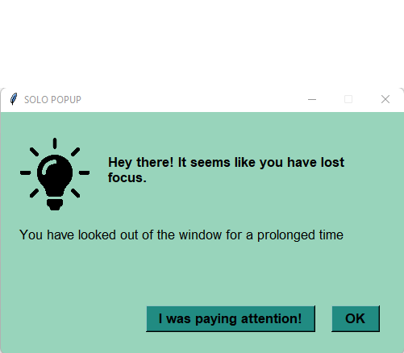
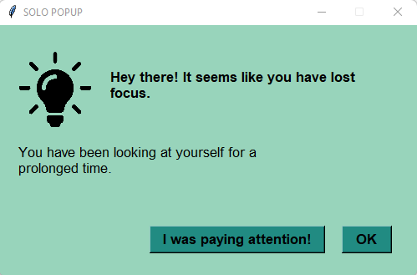
Interface for PopUps
Minimalistic
Option for the user to give feedback about his or her attention state
Adapts message based on reason for attention loss
The goal is to redirect the attention back to the presentation, not to our program

Slide 9
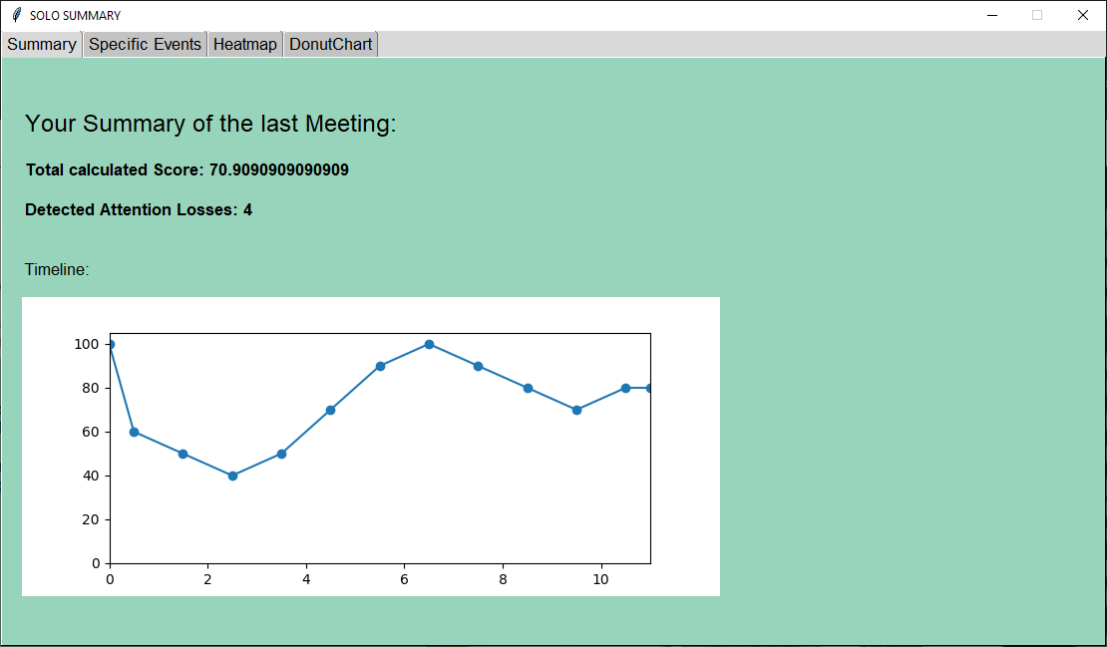
Interface for the final summary
Summary of the whole meeting
Different Statistics organized in Tabs
Give user the ability to learn from his or her attention losses
Can easily be extended to show further insights

Slide 10
Technical Structure
Notes:
Paul explains the programm from a technical standpoint

Slide 11
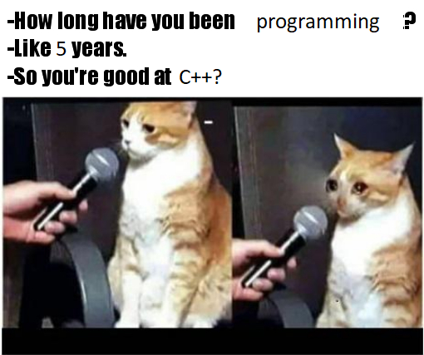
Technical Structure – C++
Hosts Tobii library
Manages eyetracker
Saves datapoints to a CSV file

Slide 12
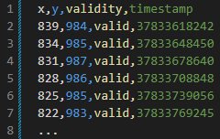
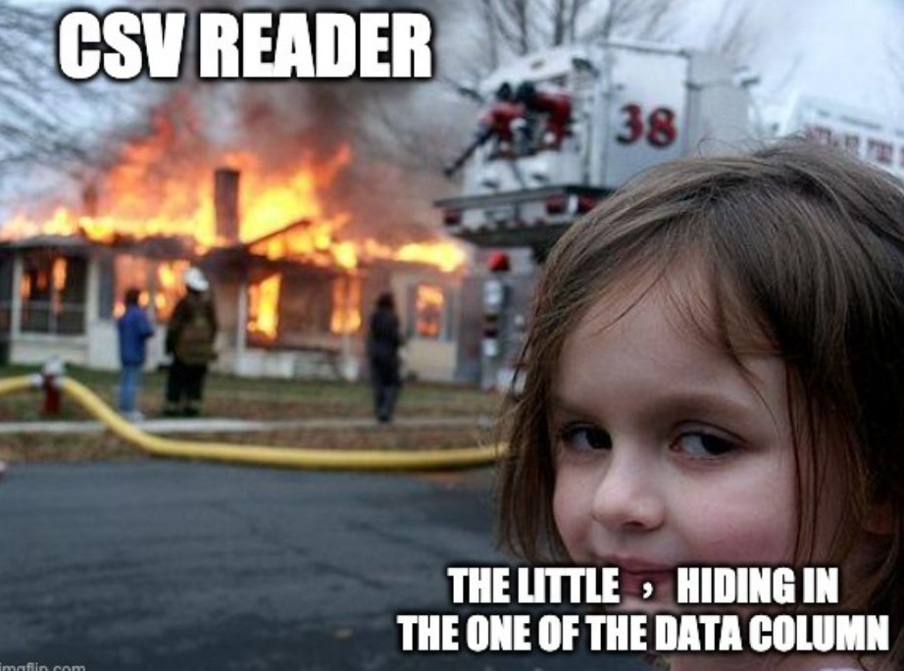
Technical Structure – CSV
X and Y coordinates (clamped)
Validity (looking on screen?)
Timestamp

Slide 13
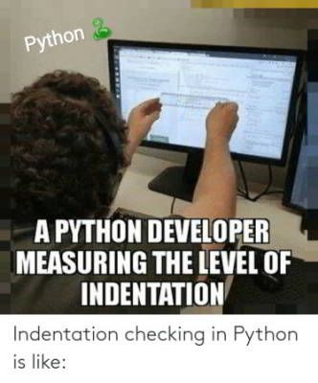
Technical Structure – Python
Reads datapoints from the CSV file
Analyses region
Tracks focus
Shows pop-ups
Generates statistics (graph, heatmap, donut chart)

Slide 14
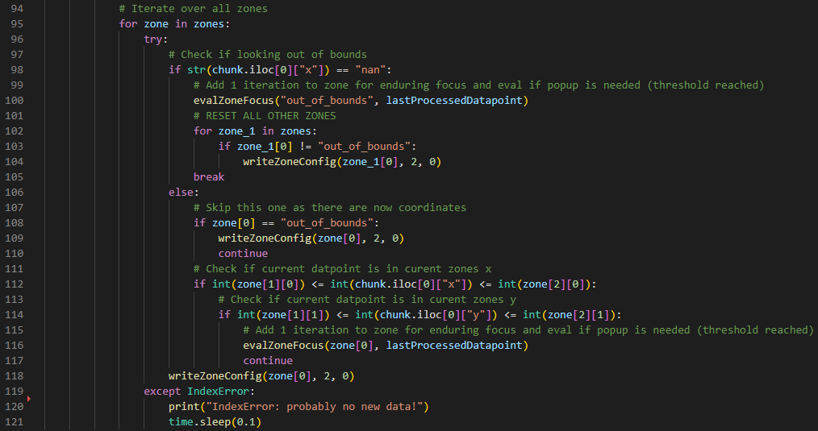
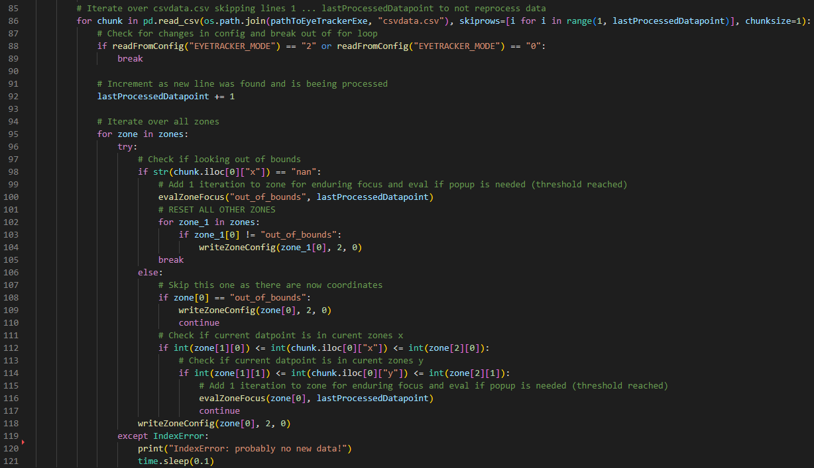
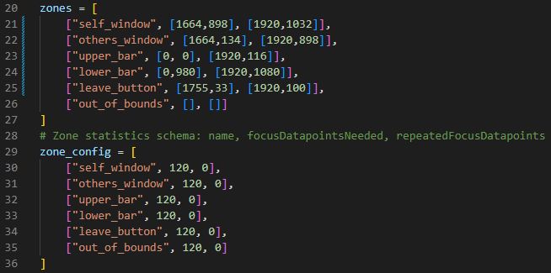
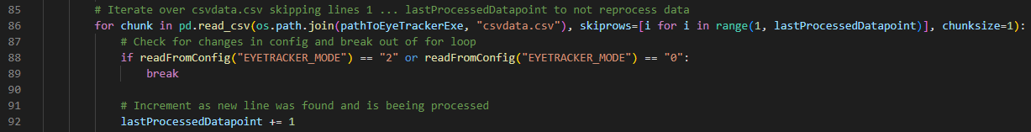
Technical Structure – Python - Analyses region

Slide 15
Technical Structure – Python
Reads datapoints from the CSV file
Analyses region
Tracks focus
Shows pop-ups
Generates statistics (graph, heatmap, donut chart)

Slide 16
Testing
Notes:
Fabian goes in depth about the testing process and its results

Slide 17


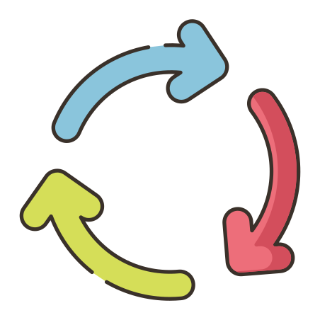







Testing – Procedure & Sample
6 Participants
(4 male, 2 female)
Age 21-31
Students
Convenience Sample

Slide 18
Results: User Perception – Ratings
Aggregated reportings:
Question (1 no - 5 absolutely) | Modus | Average | Std.-Dev.
Did the application help you to remain attentive? | 4 | 3,33 | 0,75
Did the application disrupt you? | 1 | 2,00 | 1,15
Would you like to continue using this application or parts of it? | 3; 4 | 2,83 | 1,07
Would you like to continue using Popup feature? | 4 | 3,50 | 1,26
Would you like to continue using the Dashboard feature? | 5 | 4,33 | 0,75

Slide 19

Results: User Perception – General
Basic idea
Probably especially helpful in a noisy/restless environment
With program running, subconsciously automatically more attentive to the screen
Tool restrained
It immediately reminded me to pay attention to the screen again

Slide 20

Results: User Perception – General
Technical issues
Software is too sensitive / not sensitive enough
Doubts regarding real benefits
Popup draws attention first to program rather than main content
Explanations missing
Extra hardware required
The compulsion to constantly look at the screen could perhaps also be counterproductive over a longer period of time
I felt being monitored.

Slide 21
Results: User Perception – Popups
Buttons nice
Colors nice
Texts shorts, unambiguous
Meaningful
Undisturbing
Effective
Window size and type of overlay
Surface ugly / too minimalistic
Texts too long?
It is easy and quick to get rid of the windows.
When I‘m inattentive – how should I notice there‘s a popup?!

Slide 22
Results: User Perception – Dashboard
Could support continuous improvement across individual sessions
Meaningful analyses.
Explanations/help missing
The display and listing of the different events was not particularly helpful.
Interesting to see when you paid more attention and when less.
Graph with the timeline was incomprehensible.

Slide 23
Results: User Perception – Visualizations
Heat Map fairly intuitive
Donut chart more intuitive, esp. with no previous knowledge
Donut chart gives more accurate info
Heat Map confusing
Donut chart less intuitive
Labels not entirely clear
Heat Map concept is nice, but I don't know if it's really helpful.
[In the donut chart] you can see well in the comparison of the total time, on which you have spent how much time.
I would love to use both tools.

Slide 24
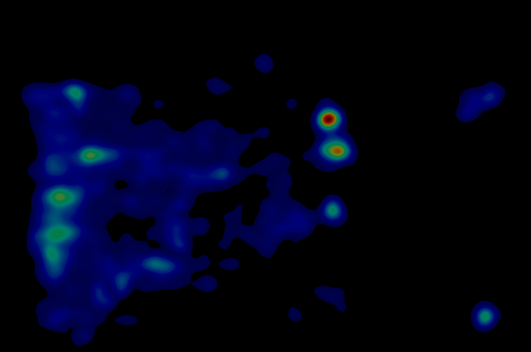
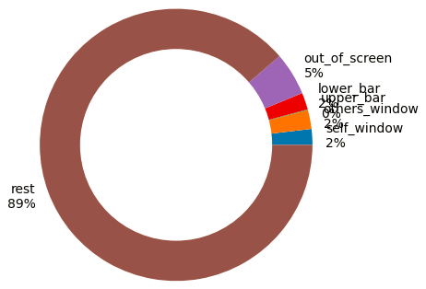
Results: User Perception – Visualizations
Heat Map fairly intuitive
Donut chart more intuitive, esp. with no previous knowledge
Donut chart gives more accurate info
Heat Map confusing
Donut chart less intuitive
Labels not entirely clear
Heat Map concept is nice, but I don't know if it's really helpful.
[In the donut chart] you can see well in the comparison of the total time, on which you have spent how much time.
I would love to use both tools.

Slide 25
Results: User Perception – Visualizations
Heat Map fairly intuitive
Donut chart more intuitive, esp. with no previous knowledge
Donut chart gives more accurate info
Heat Map confusing
Donut chart less intuitive
Labels not entirely clear
Heat Map concept is nice, but I don't know if it's really helpful.
[In the donut chart] you can see well in the comparison of the total time, on which you have spent how much time.
I would love to use both tools.

Slide 26
Outlook: Lessons Learned & Further Development
Notes:
Anne describes the possible way forward and what we would have done different

Slide 27
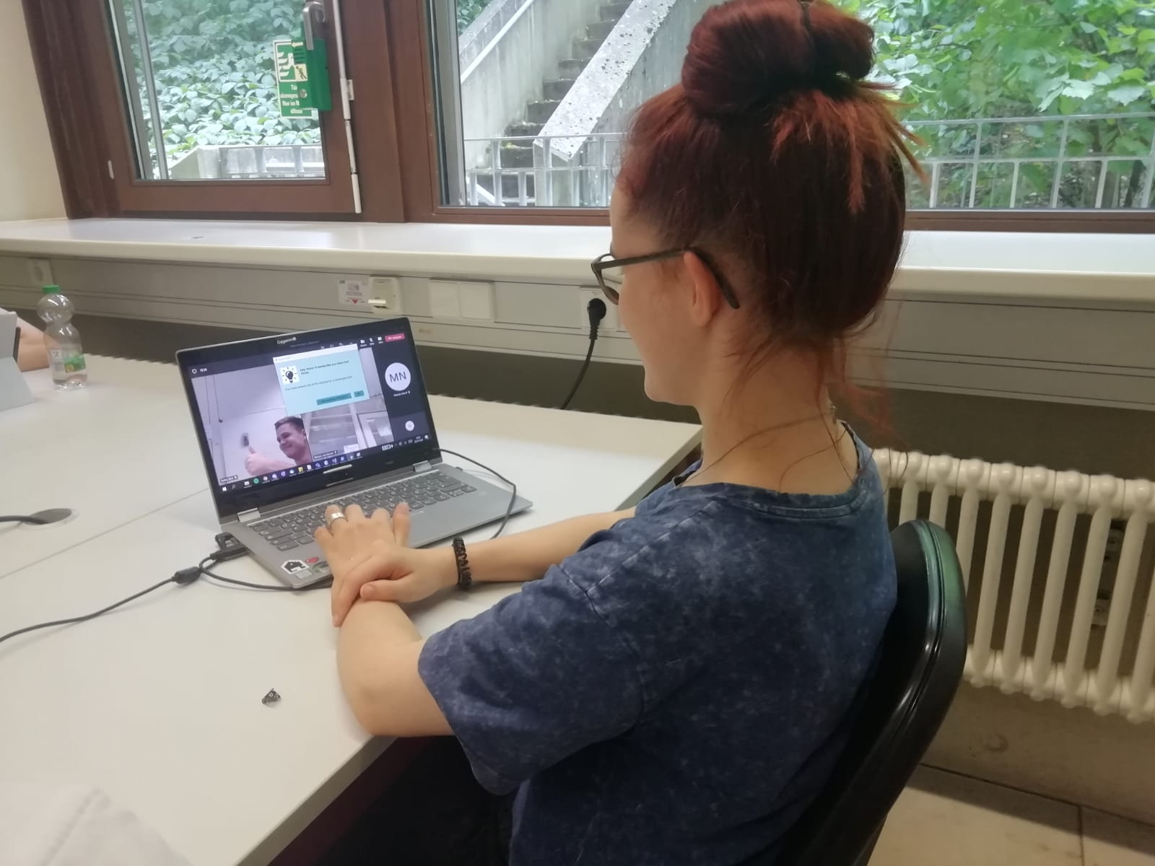


Outlook: Lessons Learned
technical issues
accuracy of the eye tracker
calibration
subject moves
→ zone definition
blinking resets the timer
explorative aspects
trigger time was picked randomly
events were picked at random
→ could lead to false positives and false negatives

Slide 28
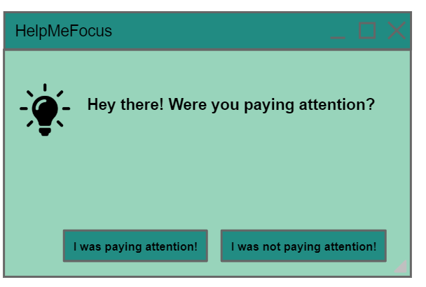

Outlook: Further Development - Machine Learning
use a machine learning approach to avoid making arbitrary assumptions
collection of test data
probe caught mind wandering
create training data from:
probe response
recorded data points before probe
continuous adaptation with user feedback
machine learning models we looked at
hidden markov models
neural networks

Slide 29
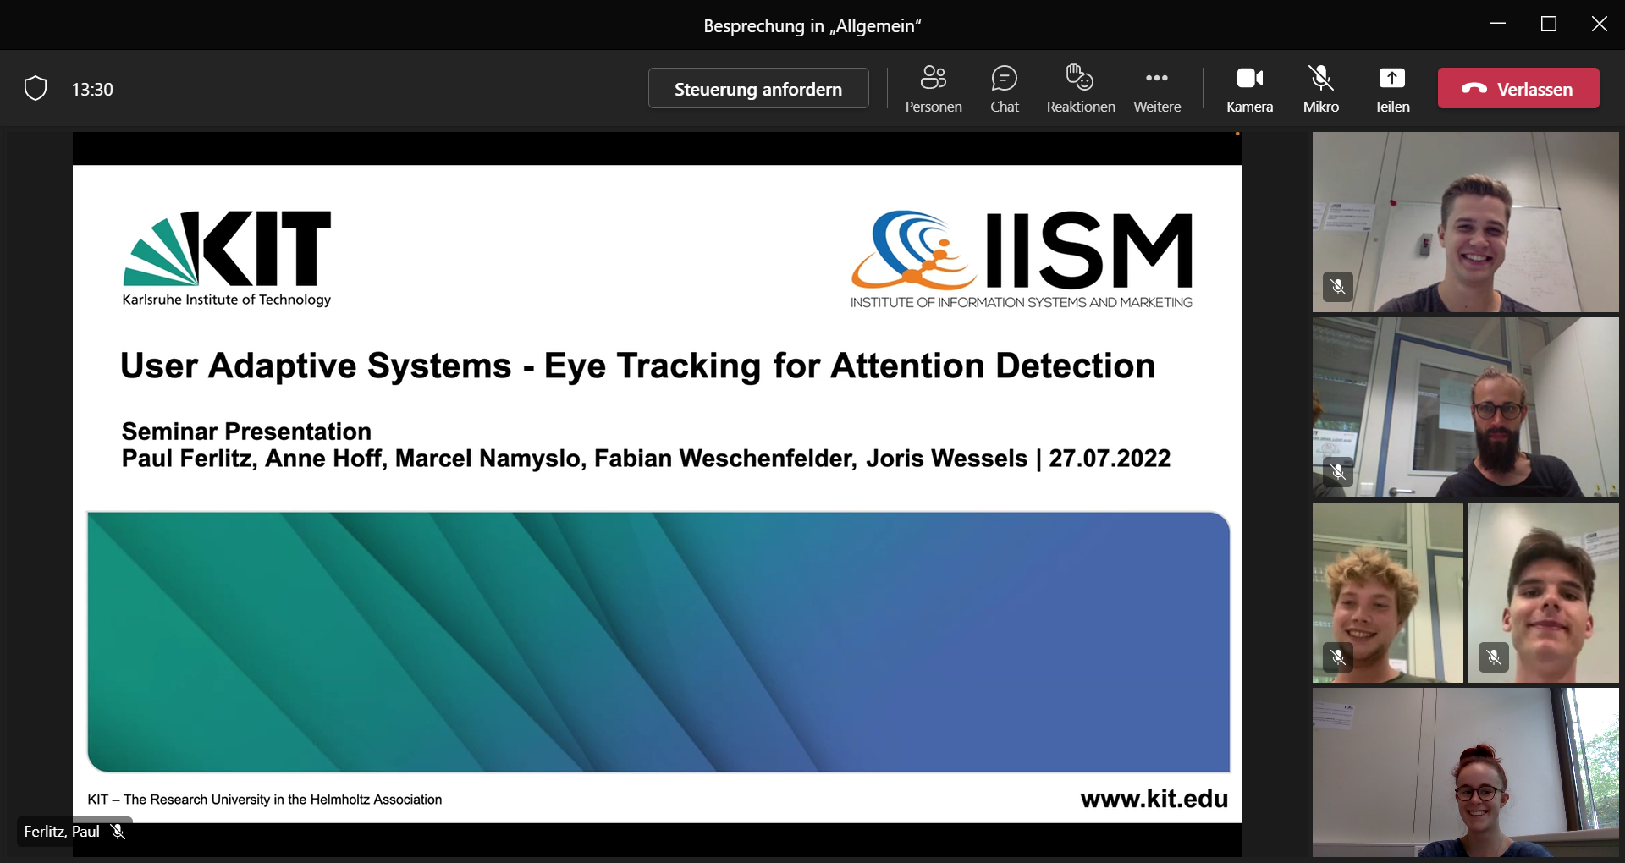
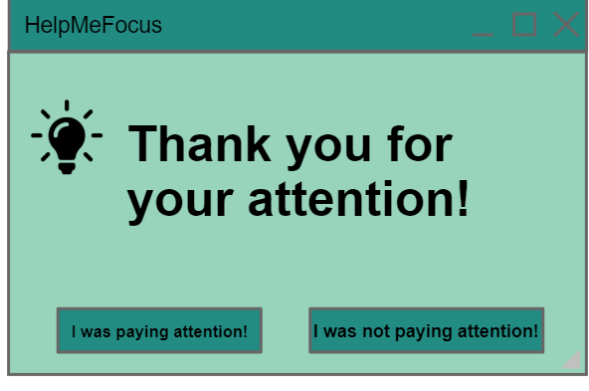
User Adaptive Systems - Eye Tracking for Attention Detection
Seminar Presentation Paul Ferlitz, Anne Hoff, Marcel Namyslo, Fabian Weschenfelder, Joris Wessels | 27.07.2022

Slide 30
Image Sources
Technical Structure - C++ https://pbs.twimg.com/media/EWsdCpqX0AA6bvo?format=png&name=small
Technical Structure - CSV https://imgflip.com/i/4tqns4
Technical Structure - Python https://i.pinimg.com/474x/10/33/37/103337054b70ccf07eb3a1f0a60a836a.jpg
Testing https://icons8.com/
Outlook https://www.dkriesel.com/_media/blog/2014/xerox-ccc-davidkriesel.pdf

Slide 31
Appendix
User Perception – Further Idea (Gamification)
Questionnaire
Quotes from the responses in the interview
Visualizations

Slide 32






Results: User Idea
“It would certainly be good to design a game according to the gamification principle and to create incentives to stay focused as much as possible.”

Slide 33
Questionnaire
General:
Let’s talk about your experience with the entire application in the experiment.
How did you perceive the application?
What did you like about it?
What didn’t you like about it?
Did the application help you to remain attentive? (1 no - 5 absolutely)
Did the application disrupt you? (1 yes, strong disruption - 5 not at all)
Would you like to continue using this application or parts of it? - If yes, why? If no, why not? (1 no - 5 absolutely)

Slide 34
Questionnaire
Popups:
Let’s talk about the popup windows shown during the meeting.
How did you perceive the popup windows?
What did you like about it?
What didn’t you like about it?
Would you like to continue using this feature? - If yes, why? If no, why not? (1 no - 5 absolutely)

Slide 35
Questionnaire
Dashboard:
Let’s talk about the dashboard shown after the meeting.
How did you perceive the dashboard?
What did you like about it?
What didn’t you like about it?
Would you like to continue using this feature? - If yes, why? If no, why not? (1 no - 5 absolutely)

Slide 36
Questionnaire
Visualizations:
Let’s talk about the specific visualizations contained in the dashboard shown after the meeting.
How did you perceive the visualizations, i.e. the Heat Map and the other one, let’s call it a donut chart?
What did you like about each of those?
What didn’t you like about each of those?
In a direct comparison, do you prefer any of those? If so, why?

Slide 37
Quotes: User Perception – General
Tool was very restrained and still served its purpose.
Probably especially helpful in a noisy/restless environment when you don't realize how distracted you are.
When I looked away, it immediately reminded me that I should look again.
If you know that the program is running, then subconsciously you automatically look much more at the screen and are more attentive.
Basic idea is not bad.

Slide 38
Quotes: User Perception – General
It didn't work when I held my phone close to the computer screen.
I feel like it doesn't help me that much, but I'm also someone else who is generally very focused.
I missed that there are explanations of the information in the dashboard. An explanatory text, especially for the heat map, would have been useful and helpful.
It is a problem that you need extra hardware to be able to use the software in everyday life.
If I get the hint that I am not attentive, then I first have to think about where and what to click now. This means that I first have to focus my attention on the program instead of being able to concentrate directly on the content again. A better alternative would have been to be able to remove the popup by moving the mouse.

Slide 39
Quotes: User Perception – General
The software is too sensitive.
The software is not sensitive enough.
When you look out the window or drink, the program thinks you're inattentive, but that's not necessarily the case.
The compulsion to constantly look at the screen could perhaps also be counterproductive over a longer period of time.
It would certainly be good to design a game according to the gamification principle and to create incentives to stay focused as much as possible.
The program interferes very much with privacy, I felt monitored.

Slide 40
Quotes: User Perception – Popups
The buttons are nice.
Nice colors.
Meaningful, not disturbing.
Effective.
Text was relatively short and unambiguous.
It is easy and quick to get rid of the windows.
The extra button was good, with which you could tell the program that you were attentive.

Slide 41
Quotes: User Perception – Popups
I didn't like the window size and type of overlay.
The surface is not pretty, too minimalistic.
The text was too long.
If the popup pops up because I'm not looking at the screen, then I don't even notice it.

Slide 42
Quotes: User Perception – Dashboard
It was good to get an analysis at all. The analysis can help to continuously improve every time you use it (i.e. across individual sessions).
Meaningful analyses.
Interesting to see when you paid more attention and when you paid less attention.
I'm very data savvy, so I like the analytics and visualizations in the dashboard.
The donut chart was very good.

Slide 43
Quotes: User Perception – Dashboard
I missed that there are explanations of the information in the dashboard. An explanatory text, especially for the heat map, would have been useful and helpful.
The display and listing of the different events was not particularly helpful.
Graph with the timeline was incomprehensible.

Slide 44
Quotes: User Perception – Visualizations
I'm familiar with the concept of the heat map and found it a nice visualization. But I don't know if it's really helpful.
I liked the donut chart. You can see well in the comparison of the total time, with which you have spent how much time.
The donut chart is more intuitive than the heat map. Especially if you have no previous knowledge.
I guess the donut chart provides more information.
The donut chart is an alternative to the heat map, which I find less intuitive, but which also offers more accurate information because there are hard percentages. I would love to use both tools.
To my taste, I liked the heat map better.

Slide 45
Quotes: User Perception – Visualizations
The labels were not entirely clear.
I was very confused by the heat map and couldn't interpret it.
The heat map is reasonably intuitive, but I missed other concise explanations.
I think I prefer the donut chart because it summarizes the information more clearly, while you have to search for it in the heat map itself and then also have to be able to interpret it.
The visualizations show you again that you are constantly being monitored, which is scary.

Slide 46
Future Work: Visualizations
Enriching the dashboard part of the program with various other/new visualization techniques:
Radial Transition Graph (RTG): (Blascheck et al. (2017) Visual comparison of eye movement patterns. Computer Graphics Forum, 36(3):87–97).)
Predecessors of the RTG: Circular Heat Map Transition Diagram: (Blascheck, T., Raschke, M., & Ertl, T. (2013). Circular heat map transition diagram. ETSA '13.)

Slide 47
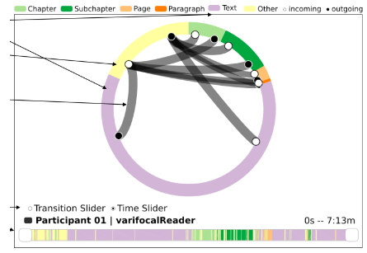
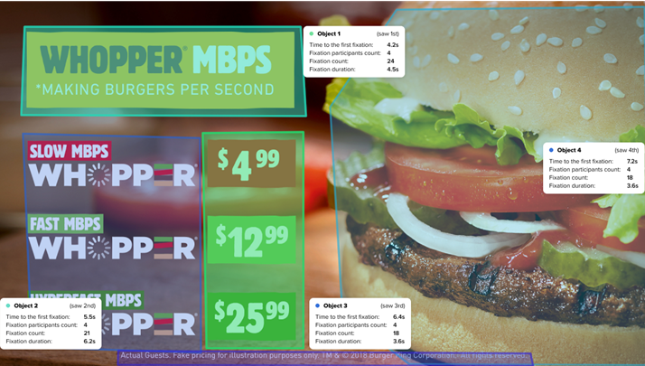
Outlook: Visualization Options
Radial Transition Graph:
Areas of Interest (AOI):

Slide 48
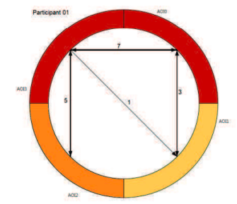
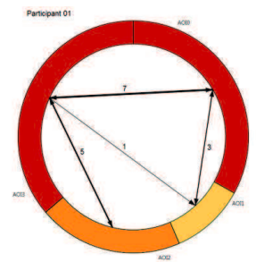
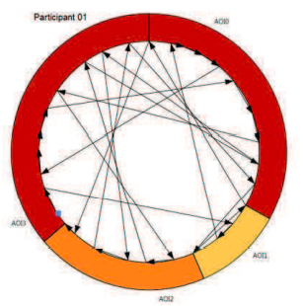
Outlook: Visualization Options
Circular Heat Map Transition Diagram (Blascheck, T., Raschke, M., & Ertl, T. (2013). Circular heat map transition diagram. ETSA '13.)
Notes:
Bild 1: The AOI transition diagram represents AOIs viewed by a participant with a color coding corresponding to the fixation count. Transitions between AOIs are represented by arrow lines where the thickness corresponds to the number of transitions..
Bild 2: AOI transition and completion time diagram for three participants. The circle segments indicate the aggregated fixation duration within an AOI.
Bild 3: Fixation transition diagram for three participants showing all fixations of the participants inside the AOIs as well as between AOIs.

